Slide 1
“ Personal Diary Management System ”
Presented by group: 07

Slide 2
Table of contents..!
00
01
02
03
04
05
Introduction
View & Search
Add New Entry
Edit & Delete
Encrypt & Decrypt
Backup System

Slide 3
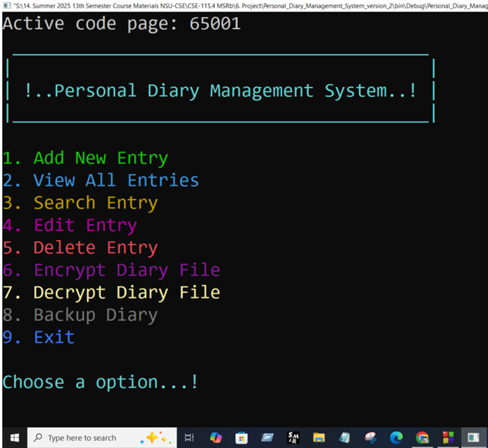
0. Introduction..!
Overview:
PDMS is a secure digital diary application. Console-based application for personal diary management system.
Features:
Add new diary entries with dates
View all entries or search by date
Edit existing entries
Delete unwanted entries
Secure encryption with password protection
Automatic timestamped backups

Slide 4
1. View & Search..!
View All Entries:
Reads and displays entire diary file
Formatting for better readability
Search Entries:
Linear search through file contents
Clear indication when no matches found
Displays complete matching entries
Md. Abul Bashar Nirob - 2022198042

Slide 5
2. Add New Entry..!
Functionality:
Appends new entries to "diary.txt" file
Stores both date and entry content
User-friendly prompts
Error handling for file operations
Clear success message after saving
Features
Users
Updates
Tashin Binte Taiba - 252 2283 642

Slide 6
3. Edit & Delete..!
Functionality:
Finds entries by date
Allows modifying entry text
Uses temporary file for safe updates
File handling with error checking
User confirmation before changes
Q1
Q2
Q3
Q4
Tasnia Afrin - 2523855642

Slide 7
4. Encrypt & Decrypt..!
Security Features:
XOR-based encryption with password
Password length verification
Header validation
Decryption Safety Checks:
Password length matching
Content structure verification
Temporary memory decryption
Sara Tasnim - 2522727042

Slide 8
5. Backup System..!
Backup Functionality:
Creates timestamped copies
Automatic filename generation
Benefits:
Data protection against accidental loss
Historical record of entries
Simple file copy operation
Jannatul Islam Eshita - 2524186042

Slide 9
Thanks..!
Do you have any questions then feel free to ask or?
abul.nirob@northsouth.edu
01404389002
Please keep this slide for attribution
Presented by group: 07

